Slide 1
UNIT 6: HEAT EXCHANGERS
LEARNING OBJECTIVES
After studying this unit you should be able to:
Classify the different types of heat exchangers
Understand the importance of the overall heat transfer coefficient in heat transfer rate analysis.
Analyse heat exchanger problems using the logarithmic mean temperature difference (LMTD) and the effectiveness- NTU methods.
Analyse the performance of heat exchangers under designed and off-design conditions.
UNIT CONTENT
SESSION 1-6: Introduction to Heat Exchangers
Analysis of Heat Exchangers
SESSION 2-6: Logarithmic Mean Temperature Difference (LMTD)
Effectiveness-Number of Transfer Units (NTU) Methods

Slide 2
SESSION 1-6: INTRODUCTION TO HEAT EXCHANGERS
Definition of Heat Exchangers
Heat exchangers are devices that allow the exchange of heat between two fluids that are at different temperatures without allowing them to mix with each other.
Heat transfer in a heat exchanger usually involves convection in each fluid and conduction through the wall separating the two fluids.
In the analysis of heat exchangers, it is convenient to work with an overall heat transfer coefficient U that accounts for the contribution of all these effects on heat transfer and the logarithmic mean temperature difference LMTD, which is an equivalent mean temperature difference between the two fluids for the entire heat exchanger.
Note:
It must be stated that the LMTD method is best suited for determining the size of a heat exchanger when the inlet and the outlet temperatures are known.
The effectiveness-NTU method is also used in heat exchanger analysis to predict the outlet temperatures of the hot and cold fluid streams in a specified heat exchanger.

Slide 3
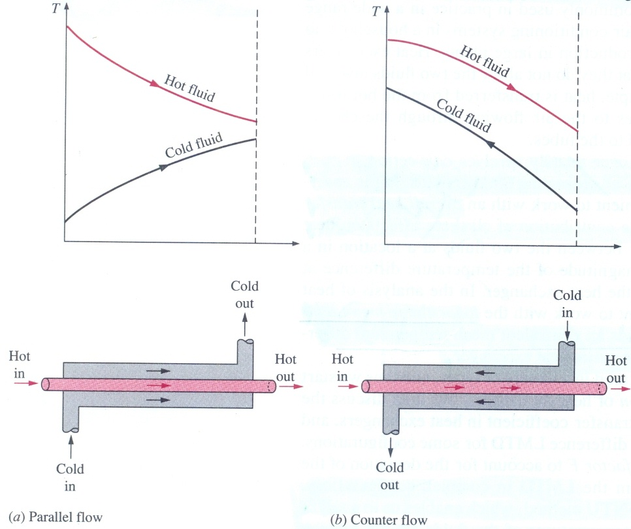
SESSION 1-6.1: TYPES OF HEAT EXCHANGERS
Different innovative heat exchanger designs have emerged in an attempt to match heat transfer hardware to the heat transfer requirements.
The simplest type of heat exchanger consists of two concentric pipes of different diameters, as shown in Figure 77, called the double-pipe heat exchanger.
Figure 77: Different flow regimes and associated temperature profiles in a double-pipe heat exchanger

Slide 4
SESSION 1-6.1: TYPES OF HEAT EXCHANGERS
One fluid in a double-pipe heat exchanger flows through the smaller pipe while the other flows through the annular space between the two pipes.
Two types of flow arrangement are possible in a double-pipe heat exchanger:
In parallel flow, both the hot and cold fluids enter the heat exchanger at the same end and move in the same direction.
In counter flow, on the other hand, the hot and cold fluids enter the heat exchanger at opposite ends and flow in opposite directions.
Compact Heat Exchanger
This type is specifically to realise a large heat transfer surface area per unit volume, of the heat exchanger.
The ratio of the heat transfer surface area of a heat exchanger to its volume is called the area density, β.
A heat exchanger with β > 700m²/m³. is classified as being compact.
Examples are the car radiator (β = 1000m²/m³) and the human lung (β = 2000m²/m³)

Slide 5
SESSION 1-6.1: TYPES OF HEAT EXCHANGER
Compact Heat Exchangers
These heat exchangers enable us to achieve high heat transfer rates between two fluids in a small volume, and are used in applications with strict limitations on the weight and volume of heat exchangers.
The large surface in compact heat exchangers is obtained by attaching fins to the walls separating the two fluids.
They are normally used in gas-to-gas and gas-to-fluid heat exchangers to counteract the low heat transfer coefficient associated with gas flow with increased surface area.
In compact heat exchangers, the two fluids usually move perpendicular to each other, and such flow configuration is called cross-flow (see Figure 78), which is further classified as mixed or unmixed flow.
In the unmixed cases the plate fins force the fluid to flow through a particular inter-fin spacing and prevent it from moving in the transverse direction (e.g. car radiator).

Slide 6
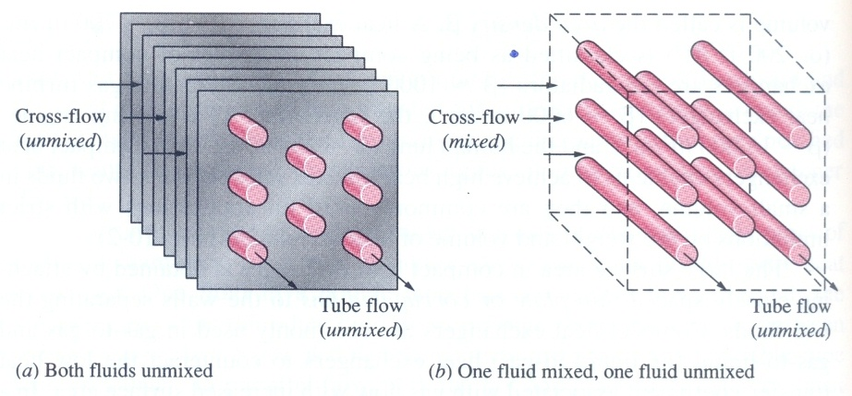
SESSION 1-6.1: TYPES OF HEAT EXCHANGERS
Figure 78: Examples of different flow configurations in cross-flow heat exchangers
In the mixed case, fluid is free to move in the transverse direction (e.g. flow of fluid through tubes with a second fluid flowing freely around the tubes, see Figure 78).

Slide 7
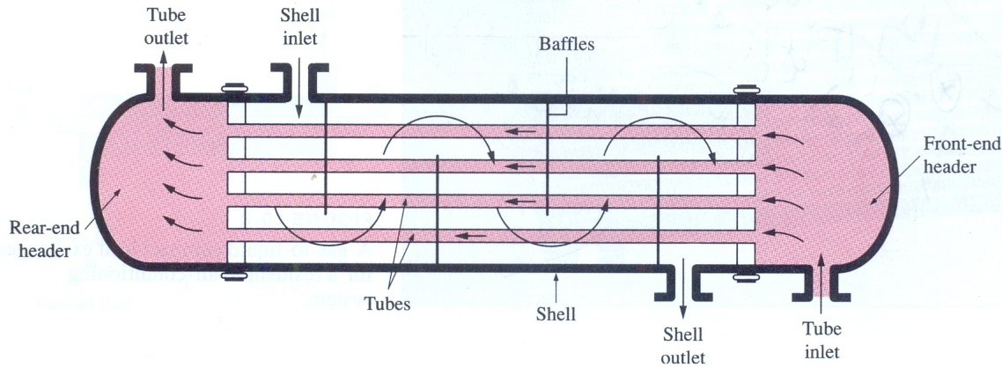
SESSION 1-6.1: TYPES OF HEAT EXCHANGER
Shell-and-tube Heat Exchanger
Figure 79: The schematic of a shell-and-tube heat exchanger (one-shell pass and one-tube pass)
The Shell-and-tube heat exchangers contain a large number of tubes packed in a shell with their axes parallel to that of the shell.

Slide 8
SESSION 1-6.1: TYPES OF HEAT EXCHANGER
Shell-and-tube Heat Exchanger
Heat transfer takes place as one fluid flows inside the tubes while the other fluid flows outside the tubes through the shell.
Baffles are commonly placed in the shell to force the shell-side fluid to flow across the shell to enhance heat transfer and to ensure uniform spacing between tubes.
Such heat exchangers have headers (large flow areas at the ends where the tube-side fluid accumulates before entering the tubes and after leaving them) at both ends of the shell.
Note:
Shell-and-tube heat exchangers are not suitable for use in automobile, aircraft, and marine applications because of their relatively large size and weight.
Shell-and-tube heat exchangers are further classified according to the number of shell and tube passes involved.

Slide 9
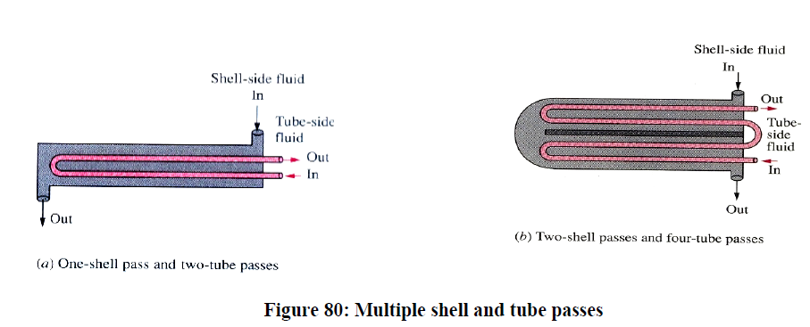
SESSION 1-6.1: TYPES OF HEAT EXCHANGER
Shell-and-tube Heat Exchanger
Heat exchangers in which all the tubes make one U-turn in the shell, for example, are called one-shell pass and two-tube passes heat exchangers (see Figure 80(a)). Likewise, a heat exchanger that involves two passes in the shell and four passes in the tubes is called a two-shell pass and four-tube pass heat exchanger (see Figure 80(b)).

Slide 10
SESSION 1-6.1: TYPES OF HEAT EXCHANGER
Regenerative Heat Exchanger
It involves the alternate passage of the hot and cold fluid streams through the same flow area.
The static-type regenerative heat exchanger is basically a porous mass that has a heat storage capacity, such as a ceramic wire mesh. Hot and cold fluids flow through this porous mass alternatively. Heat is transferred from the hot fluid to the matrix of the regenerator during the flow of the hot fluid, and from the matrix to the cold fluid during the flow of the cold fluid. Thus, the matrix serves as a temporary heat storage medium.
The dynamic-type regenerator involves a rotating drum and continuous flow of the hot fluid and cold fluid through different portions of the drum so that any portion of the drum passes periodically through the hot stream, storing heat, and then through the cold stream, rejecting this stored heat. Again the drum serves as the medium to transport the heat from the hot to the cold fluid stream.
Note:
Heat exchangers are often given specific names to reflect the specific application for which they are used. For example, a condenser is a heat exchanger in which one of the fluids gives up heat and condenses as it flows through the heat exchanger. A boiler is another heat exchanger in which one of the fluids absorbs heat and vaporises. A space radiator is a heat exchanger that transfers heat from the hot fluid to the surrounding space by radiation.

Slide 11
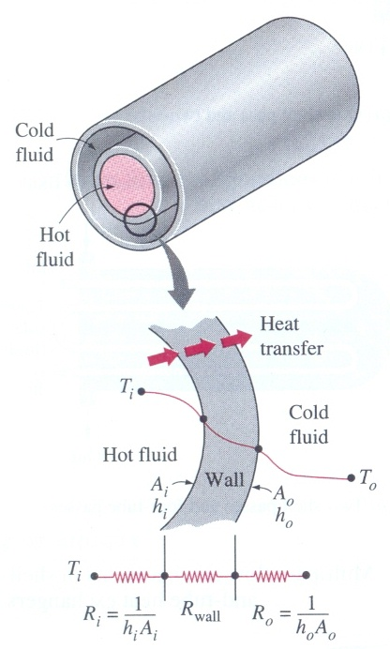
SESSION 1-6.2: OVERALL HEAT TRANSFER COEFFICIENT
A heat exchanger typically involves two flowing fluids separated by a solid wall. Any radiation effects may usually be included in the convection transfer coefficients.
The thermal resistance network associated with this heat transfer process involves two convection and one conduction resistances, as shown in Figure 79.

Slide 12
SESSION 1-6.2: OVERALL HEAT TRANSFER COEFFICIENT
The total thermal resistance of the heat exchanger becomes;
(6.2)
Where λ is the thermal conductivity of the wall material and L is the length of the tube. A_{i} is the area of the inner surface of the wall that separates the two fluids, and A_{o} is the area of the outer surface of the wall
In the analysis of heat exchangers, it is convenient to combine all the thermal resistances in the path of heat flow from the hot fluid to the cold fluid into a single resistance R, and to express the rate of the heat transfer between the two fluids as: (6.3)
where U is the overall heat transfer coefficient, whose units is W/m² K.
Cancelling ΔT , Equation 6.3 reduces to:
(6.4)

Slide 13
SESSION 1-6.2: OVERALL HEAT TRANSFER COEFFICIENT
Note:
U_{i}A_{i} = U_{o}A_{o} but U_{i} ≠ U_{o} unless A_{i} = A_{o}. Therefore, the overall heat transfer coefficient U is meaningless unless the area on which it is based is specified. This is especially the case when one side of the tube wall is finned and the other side is not, since the surface area of the finned side is several times that of the unfinned side.
When the wall thickness of the tube is small and the thermal conductivity of the tube material is high, the thermal resistance of the tube is negligible (R_{wall}= 0) and U_{i} ≈ U_{o} and
When the tube is finned on one side to enhance heat transfer, the total heat transfer surface area on the finned side becomes,
(for Isothermal fins)
(for Non-Isothermal fins)

Slide 14
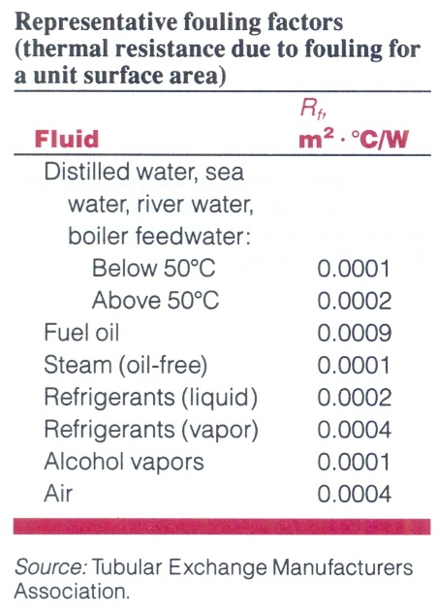
SESSION 1-6.2.1: FOULING FACTOR
The performance of heat exchangers usually deteriorates with time as a result of accumulation of deposits on heat transfer surfaces.
The layer of deposits represents additional resistance to heat transfer and causes the rate of heat transfer in a heat exchanger to decrease.

Slide 15
SESSION 1-6.2.1: FOULING FACTOR
The net effect of these accumulations on heat transfer is represented by a fouling factor, R_{f}, which is a measure of the thermal resistance introduced by the fouling.
One type of fouling is the precipitation of solid deposits in a fluid on the heat transfer surfaces. Hard water is the cause of this. The scales of such deposit come off by scratching, and the surfaces can be cleaned of such deposits by chemical treatment.
Another form of fouling, which is common in the chemical industry, is corrosion and other chemical fouling.
The fouling factor depends on the operating temperature and the velocity of the fluids, as well as the length of service. Fouling increases with increasing temperature and decreasing velocity. To account for the effects of fouling, the fouling resistance concept is introduced.
In Equation 6.2, introducing the fouling factors at the inner at outer surfaces we have:
(6.5)

Slide 16
SESSION 1-6.3: ANALYSIS OF HEAT EXCHANGERS
Assumptions:
Heat exchangers operate for long periods of time with no change in their operating conditions. Therefore, they are modelled as steady-flow devices, As such, the mass flow rate of each fluid remains constant, and the fluid properties such as temperature and velocity at any inlet or outlet remain the same.
The fluid streams experience little or no change in their velocities and elevations, and thus the kinetic and potential energy changes are negligible.
The specific heat of the fluid changes with temperature but, in a general temperature range, it can be treated as a constant at some value with very little loss of accuracy.
Axial heat conduction along the tube is usually insignificant and can be neglected.
Hence; the first law of thermodynamics requires that the rate of heat transfer from the hot fluid be equal to the rate of heat transfer to the cold one, as;
(6.6)

Slide 17
SESSION 1-6.3: ANALYSIS OF HEAT EXCHANGERS
In Heat exchanger analysis, it is convenient to combine the product of the mass flow rate and the specific heat of a fluid into a single quantity. This quantity is called the heat capacity rate and is defined as;
The heat capacity rate of a fluid stream represents the rate of heat transfer needed to change the temperature of the fluid stream by 1º C as it flows through the heat exchanger.
The fluid with a large heat capacity rate will experience a small temperature change, and the fluid with a small heat capacity rate will experience a large temperature change.
Note:
One of the fluids in a condenser or a boiler undergoes a phase-change process, and the rate of heat transfer is expressed as;
(6.7)
where ṁ is the rate of evaporation or condensation of the fluid and h_{fg} is the enthalpy of evaporation of the fluid at the specified temperature or pressure. The heat capacity rate of a fluid during a phase-change process must approach infinity since the temperature change is practically zero (see Figure 80).

Slide 18
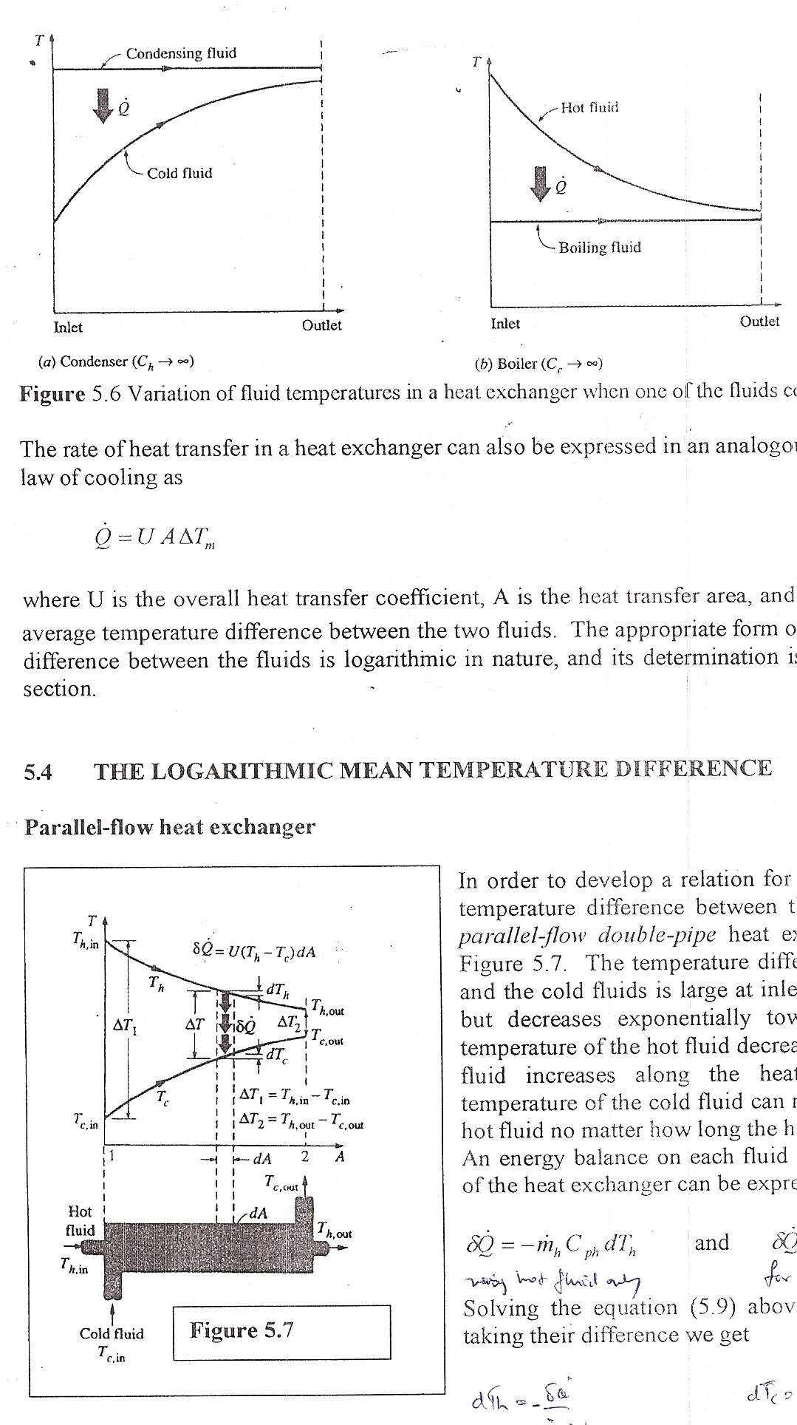
SESSION 1-6.3: ANALYSIS OF HEAT EXCHANGERS
In heat exchanger analysis, a condensing or boiling fluid is modelled as a fluid whose heat capacity rate is infinity.
That is, C = ṁC_{p}→∞ when ΔT→0 , so that the heat transfer rate is a finite quantity.
Figure 82: Variation of fluid temperatures in a heat exchanger when one all' the fluid condenses or boils

Slide 19
SESSION 1-6.3: ANALYSIS OF HEAT EXCHANGERS
The rate of heat transfer in a heat exchanger can also be expressed in an analogous manner to Newton's law of cooling as;
(6.8)
where U is the overall heat transfer coefficient, A is the heat transfer area, and ΔT_{m} is an appropriate average temperature difference between the two fluids assumed constant along the entire length of the exchanger.
The appropriate form of the mean temperature difference between the fluids is logarithmic in nature, and its determination is presented in the next section.

Slide 20
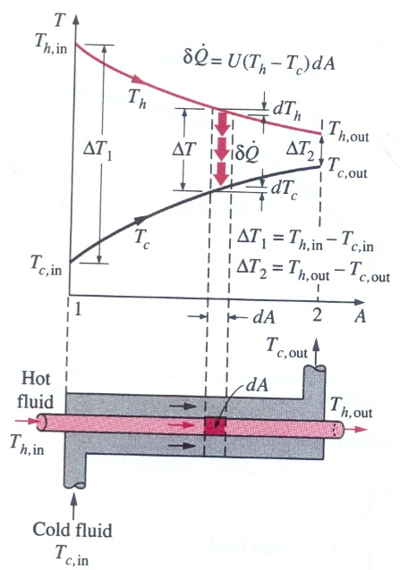
SESSION 2-6.1: LOGARITHMIC MEAN TEMPERATURE DIFFERENCE (LMTD)
Parallel-flow heat exchanger
In order to develop a relation for the equivalent average temperature difference between the fluids, consider the parallel-flow double-pipe heat exchanger, as shown in Figure 83 below.

Slide 21
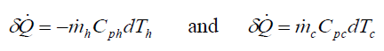
SESSION 2-6.1: LOGARITHMIC MEAN TEMPERATURE DIFFERENCE (LMTD)
Parallel-flow heat exchanger
The temperature difference between the hot and the cold fluids is large at inlet of the heat exchanger but decreases exponentially toward the outlet. The temperature of the hot fluid decrease, and that of the cold fluid increases along the heat exchanger, but the temperature of the cold fluid can never exceed that of the hot fluid no matter how long the heat exchanger is.
An energy balance on each fluid in a differential section of the heat exchanger can be expressed as:
(6.9)
Solving the equation (6.9) above for dT_{h} and dT_{c} and taking their difference we get
(6.10)
The rate of heat transfer in the differential section of the heat exchanger can also be expressed as:
(6.11)

Slide 22
SESSION 2-6.1: LOGARITHMIC MEAN TEMPERATURE DIFFERENCE (LMTD)
Parallel-flow heat exchanger
Substituting Equation 6.11 this into Equation 6.10 and rearranging gives:
(6.12)
Integrating from the inlet of the heat exchanger to its outlet, we obtain:
(6.13)
Finally, solving Equation 6.6 for ṁ_{c}Cp_{c} and ṁ_{h}Cp_{h} and substituting into Equation 6.13 gives, after some rearrangement,
(6.14)
(6.15)

Slide 23
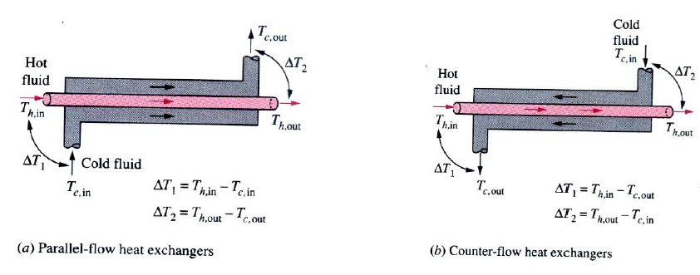
SESSION 2-6.1: LOGARITHMIC MEAN TEMPERATURE DIFFERENCE (LMTD)
Parallel-flow heat exchanger
Where ΔT_{lm} is the logarithmic mean temperature difference, which is the suitable form of the average temperature difference for use in the analysis of heat exchangers.
Here, ΔT₁ and ΔT₂ represent the temperature difference between the two fluids at the two ends (inlet and outlet) of the heat exchanger and are defined as shown in Figure 84(a) It makes no difference which end is designated as the inlet or the outlet.

Slide 24
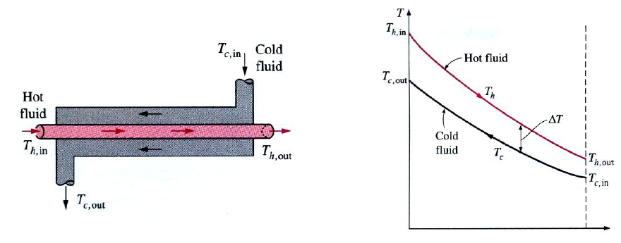
SESSION 2-6.1: LOGARITHMIC MEAN TEMPERATURE DIFFERENCE (LMTD)
Counter-flow heat exchanger
The variation of fluid temperatures in a counter-flow double-pipe heat exchanger is presented in Figure 85.

Slide 25
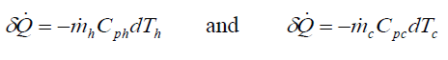
SESSION 2-6.1: LOGARITHMIC MEAN TEMPERATURE DIFFERENCE (LMTD)
Counter -flow heat exchanger
Note that the hot and cold fluids enter the heat exchanger from opposite ends, and outlet temperature of the cold fluid in this case may exceed the outlet temperature of the hot fluid. In the limiting case, the cold fluid will be heated to the inlet temperature of the hot fluid. However, the outlet temperature of the cold fluid never exceeds the inlet temperature of the hot fluid.
. An energy balance on each fluid in a differential section of the heat exchanger can be expressed as:
(6.16)
Solving the equation (6.16) above for dT_{h} and dT_{c} and taking their difference we get
(6.17)
The rate of heat transfer in the differential section of the heat exchanger can also be expressed as:
(6.18)

Slide 26
SESSION 2-6.1: LOGARITHMIC MEAN TEMPERATURE DIFFERENCE (LMTD)
Counter-flow heat exchanger
Substituting Equation 6.18 this into Equation 6.17 and rearranging gives:
(6.19)
Integrating from the inlet of the heat exchanger to its outlet, we obtain:
(6.20)
Finally, solving Equation 6.6 for ṁ_{c}Cp_{c} and ṁ_{h}Cp_{h} and substituting into Equation 6.13 gives, after some rearrangement,
(6.21)
(6.22)

Slide 27
SESSION 2-6.1: LOGARITHMIC MEAN TEMPERATURE DIFFERENCE (LMTD)
Counter-flow heat exchanger
Where ΔT_{lm} is the logarithmic mean temperature difference, which is the suitable form of the average temperature difference for use in the analysis of heat exchangers.
Here, ΔT₁ and ΔT₂ represent the temperature difference between the two fluids at the two ends (inlet and outlet) of the heat exchanger and are defined as shown in Figure 84(b) It makes no difference which end is designated as the inlet or the outlet.

Slide 28
SESSION 2-6.1: LOGARITHMIC MEAN TEMPERATURE DIFFERENCE (LMTD)
Note:
For specified inlet and outlet temperatures, the log mean temperature difference for a counter-flow heat exchanger is always greater than that for a parallel-flow heat exchanger. Thus, a smaller surface area (and thus a smaller heat exchanger) is needed to achieve a specified heat transfer rate in the counter-flow heat exchanger.
In counter-flow heat exchanger, the temperature difference between the hot and the cold fluids will remain constant along the heat exchanger when the heat capacity rates of the two fluids are equal (that is, ΔT = constant when C_{h} = C_{c}).
Then, we have ΔT₁ = ΔT₂ and the log mean temperature difference relation above gives ΔT_{lm}=0/0 , which is indeterminate. In this case, we have ΔT_{lm} =ΔT₁ =ΔT₂
A condenser or boiler can be considered to be either a parallel- or counter-flow heat exchanger since both approaches give the same result.

Slide 29
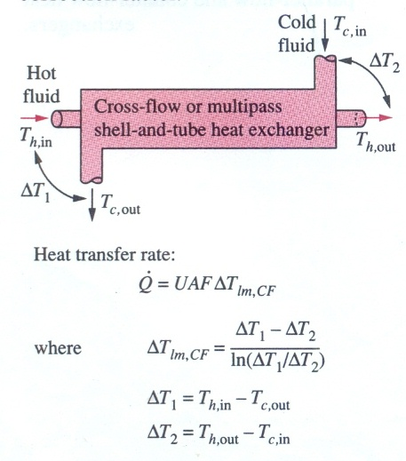
MULTI PASS AND CROSS FLOW HEAT EXCHANGERS (The Use of a Correction Factor, F)
In such cases, it is convenient to relate the equivalent temperature difference to the log mean temperature difference relation for the counter-flow case as:
(6.23)
where F is the correction factor, which depends on the geometry of the heat exchanger and the inlet and outlet temperatures of the hot and cold fluid streams.

Slide 30
MULTI PASS AND CROSS FLOW HEAT EXCHANGERS (The Use of a Correction Factor, F)
The correction factor is less than unity for a cross-flow and multi-pass shell-and-tube heat exchanger. Thus, the correction factor is a measure of deviation of the log mean temperature from the corresponding values of the counter-­flow case.
The correction factor F for common cross-flow and shell-and-tube heat exchanger configurations is given in Figure 87 versus two temperature ratios defined as:
(6.24)
where the subscripts 1 and 2 represent the inlet and outlet, respectively.
Note that for the shell-and-tube heat exchanger, T and t represent the shell- and tube-side temperatures, respectively, as shown in the correction factor charts. The determination of the correction factor F requires the availability of the inlet and outlet temperatures for both the cold and hot fluids.
Note that the value of P ranges from 0 to 1. The value of R ranges from 0 (for phase change condition on shell side) to infinity (phase change on the tube side). The correction factor for a condenser or boiler is unity regardless of the configuration of the heat exchanger.

Slide 31
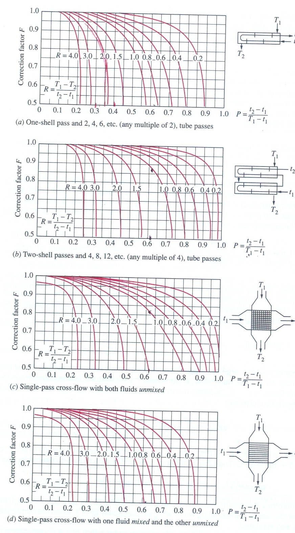
Correction Factor, F Charts for common shell-and tube and cross flow heat exchangers

Slide 32
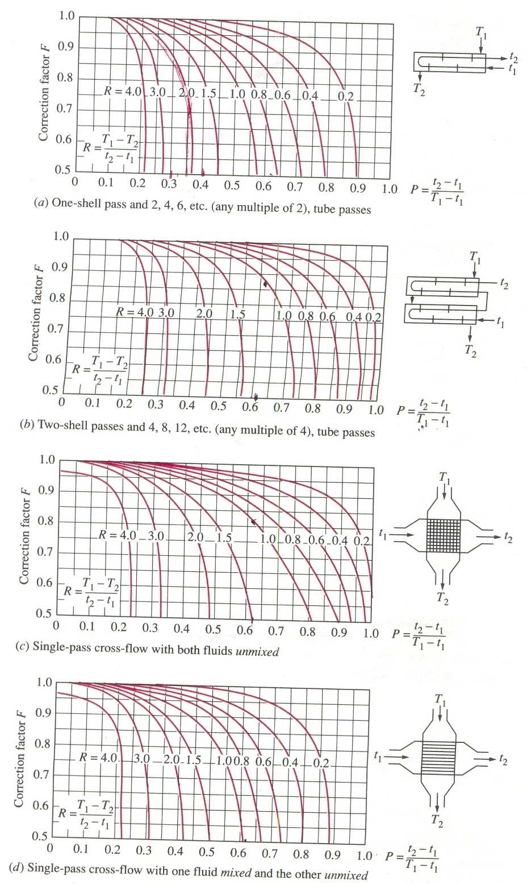
Correction Factor, F Charts for common shell-and tube and cross flow heat exchangers

Slide 33
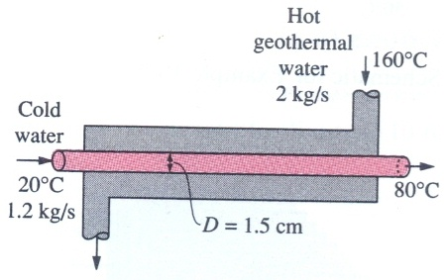
Worked Example 6.1: Heating Water in a Counter- Flow Heat Exchanger
Question
A counter-flow double-pipe heat exchanger is to heat water from 20 ºC to 80 ºC at a rate of 1.2 kg/s. The heating is to be accomplished by geothermal available at 160ºC at a mass flow rate of 2 kg/s. The inner tube is thin-walled and has a diameter of 1.5 cm. If the overall heat transfer coefficient of the heat exchanger is 640 W/m².ºC, determine the length of the heat exchanger required to achieve the desired heating.
Solution: Water is heated in a counter-flow double-pipe heat exchanger by geothermal water. The required length of the heat exchanger is to be determined.

Slide 34
Worked Example 6.1: Heating Water in a Counter- Flow Heat Exchanger
Assumptions:
(1) Steady operating conditions exist.
(2) The heat exchanger is well insulated so that heat loss to the surroundings is negligible and thus heat transfer from the hot fluid is equal to heat transfer to the cold fluid.
(3) Changes in the kinetic and potential energies of the fluid streams are negligible. (4) There is no fouling.
(5) Fluid properties are constant.
Properties:
Specific heats of water and geothermal fluid are 4.18 and 4.31 kJ/kg.ºC, respectively.
Analysis:
The rate of heat transfer in the heat exchanger can be determined from:

Slide 35
Worked Example 6.1: Heating Water in a Counter- Flow Heat Exchanger
Analysis:
Noting that all of this heat is supplied by the geothermal water, the outlet temperature of the geothermal water is determined to be:
Knowing the inlet and outlet temperatures of both fluids, the logarithmic mean temperature difference for this counter-flow heat exchanger becomes:
Then, the surface area of the heat exchanger is determined to be:
Discussion: The inner tube of this counter-flow heat exchanger (and thus the heat exchanger itself) needs to be over 100 m long to achieve the desired heat transfer, which is impractical.

Slide 36
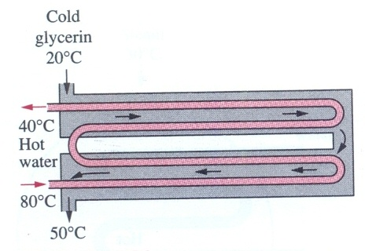
Worked Example 6.2: Heating of Glycerin in a Multi-pass Heat Exchanger
Question
A 2-shell passes and 4-tube passes heat exchanger is used to heat glycerin from 20 ºC to 50ºC by hot water, which enters the thin-walled 2-cm-diameter tubes at 80 ºC and leaves at 40 ºC .The total length of the tubes in the heat exchanger is 60 m. The convection heat transfer coefficient is 25 W/m².ºC on the glycerin (shell) side and 160 W/m².ºC on the water (tube) side. Determine the rate of heat transfer in the heat exchanger (a) before any fouling occurs and (b) after fouling with a fouling factor or 0.0006 m².ºC/W occurs on the outer surfaces of the tubes.
Solution: Glycerin is heated in a 2-shell passes and 4-tube passes heat exchanger by hot water. The rate of heat transfer for the cases of fouling and no fouling is determined.

Slide 37
Worked Example 6.2: Heating of Glycerin in a Multi-pass Heat Exchanger
Assumptions:
(1) Steady operating conditions exist.
(2) The heat exchanger is well insulated so that heat loss to the surroundings is negligible and thus heat transfer from the hot fluid is equal to heat transfer to the cold fluid.
(3) Changes in the kinetic and potential energies of the fluid streams are negligible. (4) Heat transfer coefficients and fouling factors are constant and uniform.
(5) The thermal resistance of the inner tube is negligible since the tube is thin-walled and highly conductive.
Analysis:
The tubes are said to be thin-walled, and thus it is reasonable to assume the inner surface area of the tubes to be equal to the outer surface area. Then the heat transfer surface area of this heat exchanger becomes:
The rate of heat transfer in this heat exchanger can be determined from:

Slide 38
Worked Example 6.2: Heating of Glycerin in a Multi-pass Heat Exchanger
Analysis:
These quantities are determined from:
In the case of no fouling, the overall heat transfer coefficient U is determined from:
Then the rate of heat transfer becomes:

Slide 39
Worked Example 6.2: Heating of Glycerin in a Multi-pass Heat Exchanger
Analysis:
When there is fouling on one of the surfaces, the overall heat transfer coefficient U is determined from:
Then the rate of heat transfer becomes:
Discussion: Note that the rate of heat transfer decreases as a result of fouling, as expected. The decrease is not dramatic, however, because of the relatively low convection heat transfer coefficients involved.

Slide 40
SESSION 2-6.2: THE EFFECTIVENESS – NTU METHOD
Recap of LMTD
The log mean temperature difference (LMTD) is easy to use in heat exchanger analysis when the inlet and the outlet temperatures of the hot and cold fluids are known or can be determined from an energy balance.
With the LMTD method, the task is to select a heat exchanger that will meet the prescribed heat transfer requirements. The procedure to follow in the selection process is as follows:
Select the type of heat exchanger suitable for the application.
Determine any unknown inlet and outlet temperature and the heat transfer rates using an energy balance.
Calculate the log mean temperature difference and the correction factor, if necessary.
Obtain (select or calculate) the value of the overall heat transfer coefficient U.
Calculate the heat transfer surface area A.
The task is completed by selecting a heat exchanger that has a heat transfer surface area equal to or larger than A.

Slide 41
SESSION 2-6.2: THE EFFECTIVENESS – NTU METHOD
A second kind of problem encountered in heat exchanger analysis is the determination of heat transfer rate and the unknown outlet temperatures of both the hot and cold fluids for prescribed fluid mass flow rates and inlet temperatures when the type and size of the heat exchanger are specified. The effectiveness-NTU method is employed conveniently in this case.
This new method is based on a dimensionless parameter called the heat transfer effectiveness ε , defined as:
(6.25)
The actual heat transfer rate in a heat exchanger can be determined from an energy balance on the hot or cold fluid streams and can be expressed as,
(6.26)

Slide 42
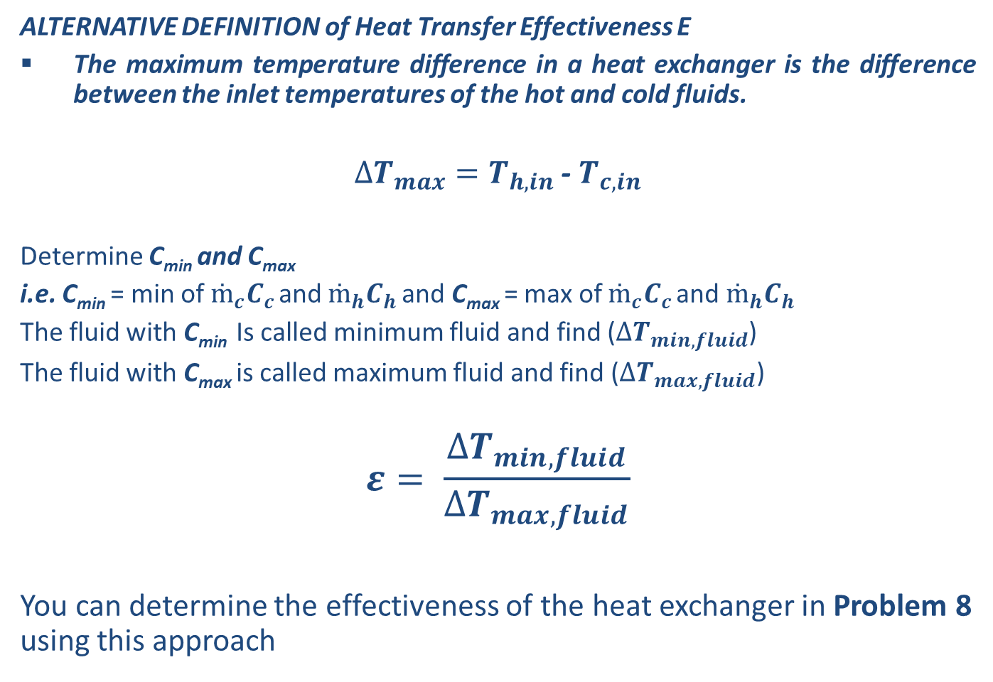
SESSION 2-6.2: THE EFFECTIVENESS – NTU METHOD
ALTERNATIVE DEFINITION of Heat Transfer Effectiveness Ε
The maximum temperature difference in a heat exchanger is the difference between the inlet temperatures of the hot and cold fluids.
$∆T_{max}=T_{h, in}$ - $T_{c,in}$
Determine C_{min} and C_{max}
i.e. C_{min} = min of $ṁ_{c}C_{c }$and $ṁ_{h}C_{h }$and C_{max} = max of $ṁ_{c}C_{c }$and $ṁ_{h}C_{h }$
The fluid with C_{min} Is called minimum fluid and find ($∆T_{min, fluid}$)
The fluid with C_{max} is called maximum fluid and find ($∆T_{max, fluid}$)
$$ε= \frac{∆T_{min, fluid}}{∆T_{max, fluid}}$$
You can determine the effectiveness of the heat exchanger in Problem 8 using this approach

Slide 43
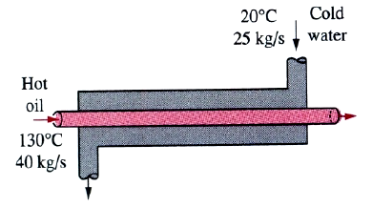
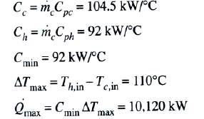
SESSION 2-6.2: THE EFFECTIVENESS – NTU METHOD
Note:
It must be noted that the heat transfer in a heat exchanger will reach its maximum value when (1) the cold fluid is heated to the inlet temperature of the hot fluid or (2) the hot fluid is cooled to the inlet temperature of the cold fluid.
These limiting conditions will not be attained unless the heat capacity rates of the two fluids are identical (i.e. C_{c} = C_{h}). When C_{c} ≠ C_{h}, the fluid with the smaller heat capacity rate will experience the maximum temperature, at which heat transfer will come to a halt.
Figure 90: Counter flow heat exchanger

Slide 44
SESSION 2-6.2: THE EFFECTIVENESS – NTU METHOD
Therefore, the maximum possible heat transfer rate in a heat exchanger is (see Figure 90 above);
(6.27)
Thus, once the effectiveness is known, the actual heat transfer rate can be evaluated from the relation:
(6.28)
In this way, the heat transfer can be determined without knowing the outlet temperatures of the fluids. The effectiveness depends on the geometry of the heat exchanger as well as the flow arrangement.

Slide 45
SESSION 2-6.2: THE EFFECTIVENESS – NTU METHOD
Parallel flow in double-pipe heat exchanger
Rearranging equation (6.13), developed for a parallel-flow heat exchanger, we obtain;
(6.29)
Also, solving Equation 6.6 for T_{h,out} gives:
(6.30)
Substituting this into equation (6.29), after adding and subtracting T_{c,in} gives:
(6.31)
which simplifies to:
(6.32)

Slide 46
SESSION 2-6.2: THE EFFECTIVENESS – NTU METHOD
Parallel flow in double-pipe heat exchanger
But,
(6.33)
Substituting this result into Equation 6.32, and solving for gives the following relation for the effectiveness of a parallel-flow heat exchanger:
(6.34)
Taking either C_{c} or C_{h} to be C_{min} (both approaches the same result), the relation can be expressed more conveniently as:
(6.35)

Slide 47
SESSION 2-6.2: THE EFFECTIVENESS – NTU METHOD
Parallel flow in double-pipe heat exchanger
Effectiveness relations involve the dimensionless group,
This quantity is called the number of transfer units (NTU) and is expressed as:
(6.36)
Note that the NTU is proportional to A. For specified values of U and C_{min}, the NTU is a measure of the heat transfer surface area A. Thus, the larger the NTU, the larger the heat exchanger. The effectiveness is a function of the number of transfer units (NTU) and the capacity ratio C (i.e. C_{min} / C_{max}).
The effectiveness of some common types of heat exchangers are plotted in Figure 91. Effectiveness relations have also been developed for a large number of heat exchangers, and the results are given in Table 14. Table 15 gives NTU directly when the effectiveness is known.

Slide 48
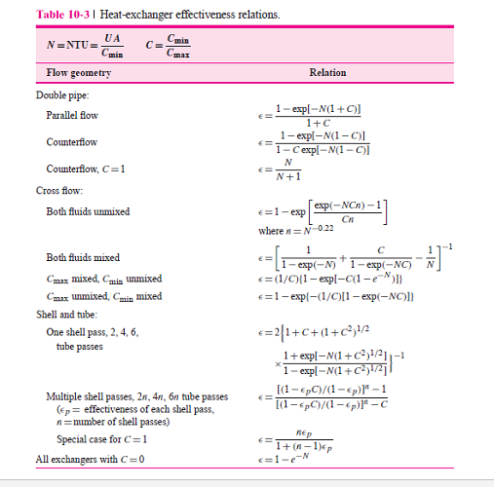
SESSION 2-6.2: THE EFFECTIVENESS – NTU METHOD
Table 14: Effectiveness Relations for heat exchangers

Slide 49
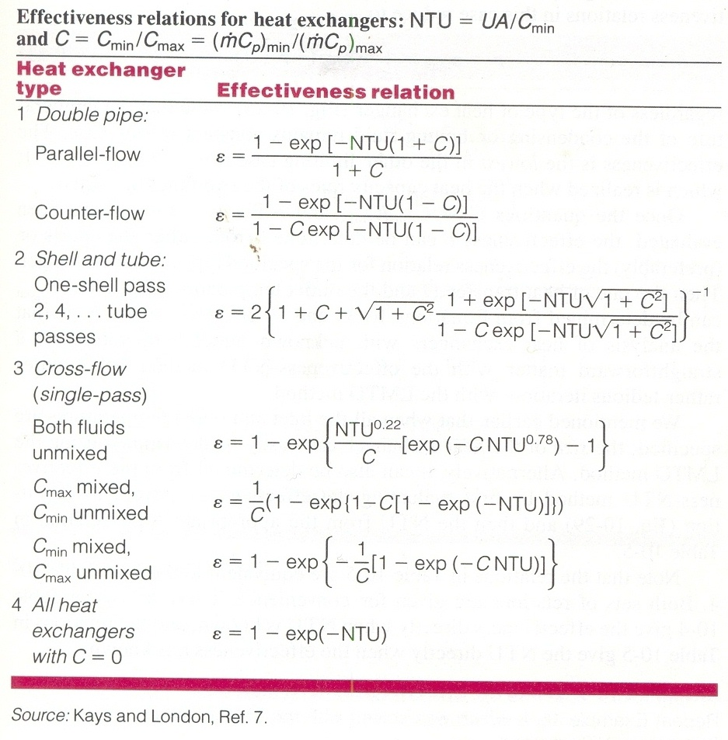
SESSION 2-6.2: THE EFFECTIVENESS – NTU METHOD
Table 14: Effectiveness Relations for heat exchangers
Applicable to Condensers, Boilers, and Evaporators

Slide 50
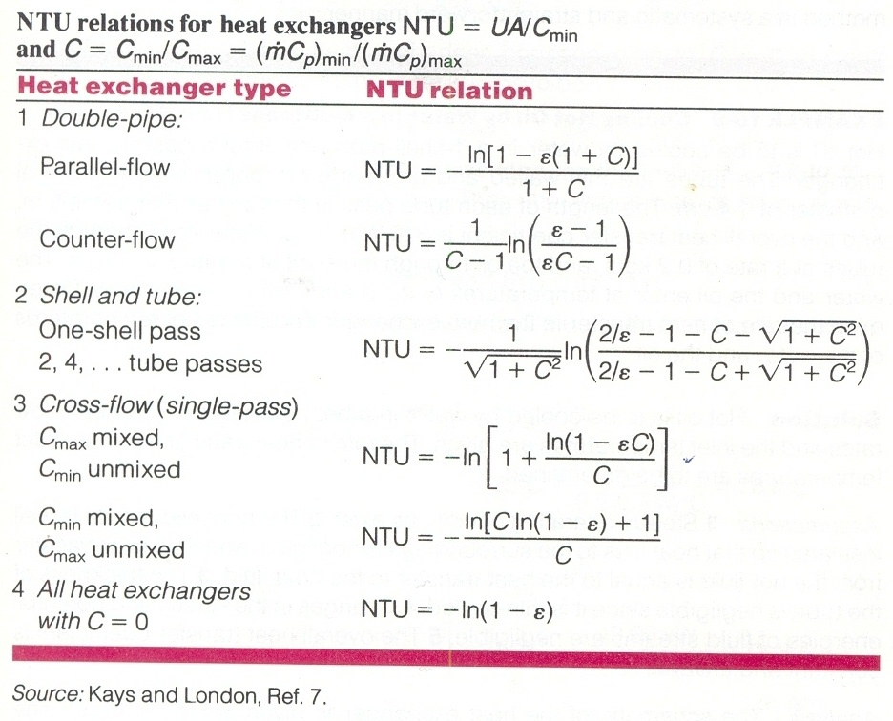
SESSION 2-6.2: THE EFFECTIVENESS – NTU METHOD
Table 15: NTU Relations for heat exchangers
Applicable to Condensers, Boilers, and Evaporators

Slide 51
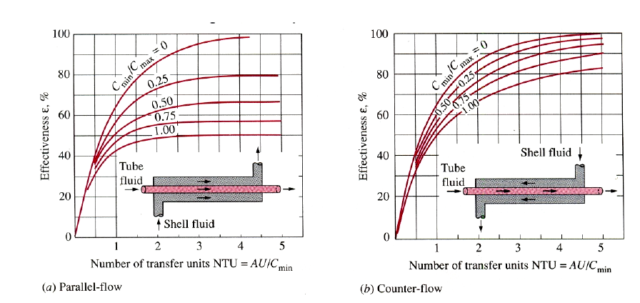
SESSION 2-6.2: THE EFFECTIVENESS – NTU METHOD
Figure 91: Effectiveness of some common types of heat exchangers

Slide 52
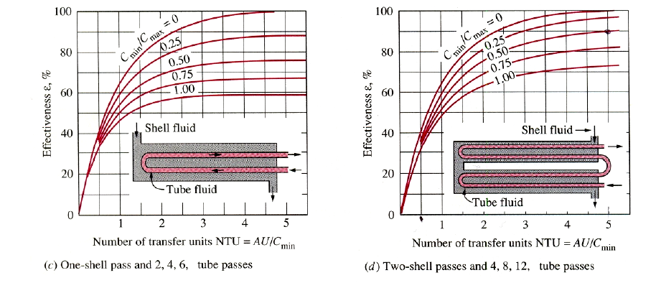
SESSION 2-6.2: THE EFFECTIVENESS – NTU METHOD
Figure 91: Effectiveness of some common types of heat exchangers

Slide 53
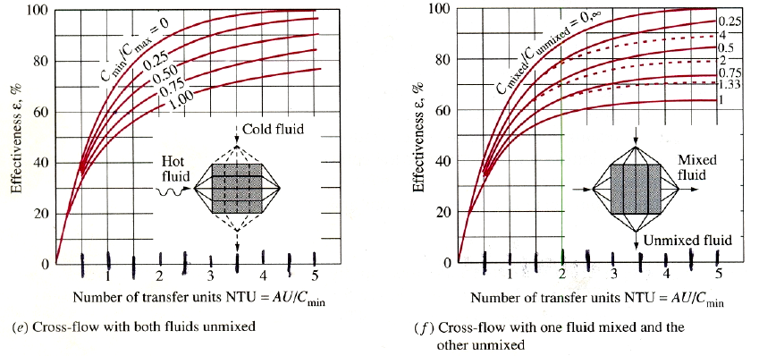
SESSION 2-6.2: THE EFFECTIVENESS – NTU METHOD
Figure 91: Effectiveness of some common types of heat exchangers

Slide 54
Worked Example 6.3: Cooling Hot Oil by Water in a Multi-pass Heat Exchanger
Question:
Hot oil is to be cooled by water in a 1-shell-pass and 8-tube-passes heat exchanger. The tubes are thin-walled and are made of copper with an internal diameter of 1.4 cm.
The length of each tube pass in the heat exchanger is 5 m, and the overall heat transfer coefficient is 310 W/m².ºC. Water flows through the tubes at a rate of 0.2 kg/s, and the oil through the shell at a rate of 0.3 kg/s. The water and the oil enter at temperatures of 20 ºC and 150 ºC, respectively.
Specific heats of water and oil are to be assumed as 4.18 and 2.13 kJ/kg.ºC, respectively. Determine the rate of heat transfer in the heat exchanger and the outlet temperatures of the water and the oil.
Solution:
Hot oil is to be cooled by water in a heat exchanger. The mass flow rates and the inlet temperatures are given. The rate of heat transfer and the outlet temperatures are to be determined.

Slide 55
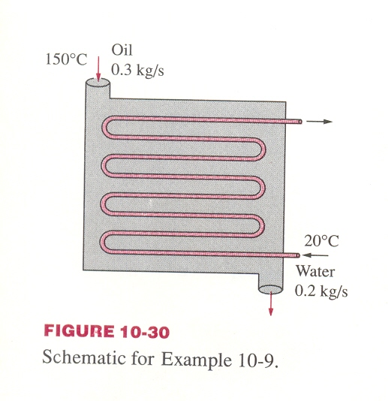
Worked Example 6.3: Cooling Hot Oil by Water in a Multi-pass Heat Exchanger
Figure 92 schematic for worked example 6.3
Assumptions:
Steady operating conditions exist.
The heat exchanger is well insulated so that heat loss to the surroundings is negligible and thus heat transfer from the hot fluid is equal to heat transfer to the cold fluid.
Changes in the kinetic and potential energies of the fluid streams are negligible.
The thickness of the tube is negligible since it is thin-walled.
The overall heat transfer coefficient is constant and uniform.

Slide 56
Worked Example 6.3: Cooling Hot Oil by Water in a Multi-pass Heat Exchanger
Analysis:
The outlet temperatures are not specified, and they cannot be determined from an energy balance. The use of the LMTD method in this case will involve tedious iterations, and thus the ε-NTU method is indicated. The first step in the ε-NTU method is to determine the heat capacity rates of the hot and cold fluids and identify the smaller one:
Therefore,
Then the maximum heat transfer rate is determined to be:

Slide 57
Worked Example 6.3: Cooling Hot Oil by Water in a Multi-pass Heat Exchanger
Then the NTU of this heat exchanger becomes:
The effectiveness of this heat exchanger corresponding to C = 0.764 and NTU = 0.854 is determined from Figure 91 (c) to be: ε = 0.49
Alternatively, the effectiveness could be determined more accurately from the third relation in Table 14 but with more labour.
Then, the actual rate of heat transfer becomes:

Slide 58
Worked Example 6.3: Cooling Hot Oil by Water in a Multi-pass Heat Exchanger
Finally, the outlet temperatures of the cold and the hot fluid streams are determined to be:
Therefore, the temperature of the cooling water will rise from 20 ºC to 68.7 ºC as it cools the hot oil from 150 ºC to 86.3 ºC in this heat exchanger.

Slide 59
Worked Example 6.4: Use of a 2-pass shell-and- tube heat exchanger to condense a chemical
Question:
A two-pass shell-and-tube heat exchanger is used to condense a chemical on the shell side at a rate of 50 kg/s at a saturation temperature of 80 ºC. The chemical enters as a dry saturated vapour and is not under-cooled during the process. Water at 10 ºC and a mass flow rate of 100 kg/s is available as coolant; the velocity of the water is to be approximately 1.5 m/s. Using the data below and taking a nominal tube diameter of 25 mm, neglecting tube wall thickness, calculate:
The number of tubes required; The tube length; The number of transfer units;
The effectiveness of the heat exchanger.
Data: Specific enthalpy of vaporisation of chemical, 417.8 kJ/kg; heat transfer coefficient for shell side, 10 W/m²K; fouling factor for shell side, 0.1 m²K/kW; fouling factor for tube side, 0.2 m²K/kW.
For turbulent flow in a pipe, take
with all properties at the mean bulk temperature.

Slide 60
Worked Example 6.4: Use of a 2-pass shell-and- tube heat exchanger to condense a chemical
Solution:
Water flows in the tubes and the chemical flow in the shell. Water is the cold fluid while the chemical is the hot fluid.
Assumptions:
Steady operating conditions exist.
The heat exchanger is well insulated so that heat loss to the surroundings is negligible and thus heat transfer from the hot fluid is equal to heat transfer to the cold fluid.
Changes in the kinetic and potential energies of the fluid streams are negligible.
The thickness of the tube is negligible since it is thin-walled.
The overall heat transfer coefficient is constant and uniform.
Analysis:
Heat transferred is calculated as:

Slide 61
Worked Example 6.4: Use of a 2-pass shell-and- tube heat exchanger to condense a chemical
Assuming the specific heat capacity of water as 4.2 kJ/kg K, the exit temperature of water in the tube can be determined from:
Mean bulk temperature of water in the tube can then be obtained as:
From page 10 of the steam tables, properties of liquid water at 35ºC can be read as:
v_{f} = 0.001006m³/kg, μ_{f} = 718 x 10⁻⁶ kg/ms, λ_{f} = 625 x 10⁻⁶ kW/mK,
Pr_{f} = 4.80

Slide 62
Worked Example 6.4: Use of a 2-pass shell-and- tube heat exchanger to condense a chemical
Mass flow rate of water = (number of tubes) x (mass flow rate per tube)
From the relation above,
For the two tube passes in the shell [see Figure 88(a)], total number of tubes = 2 x 137 = 274 tubes.
From Equation 6.37, n is inversely proportional to V. Hence, for 137 tubes, the actual velocity of water can be obtained as:

Slide 63
Worked Example 6.4: Use of a 2-pass shell-and- tube heat exchanger to condense a chemical
Then,
The value of the Re exceeds the critical value of 2300 for flow through a tube; hence, the flow is turbulent.
The Nusselt number can then be obtained by:
The heat transfer coefficient within the tube h_{t} can be determined as:

Slide 64
Worked Example 6.4: Use of a 2-pass shell-and- tube heat exchanger to condense a chemical
Then,
For A_{i}≈A_{o} , the overall heat transfer coefficient will be:
The rate of heat transfer in this heat exchanger can also be expressed as:

Slide 65
Worked Example 6.4: Use of a 2-pass shell-and- tube heat exchanger to condense a chemical
The correction factor for a condenser or boiler is unity regardless of the configuration of the heat exchanger; hence, F = 1.
Area required can then be computed as:
Tube length to provide the required area:
The chemical will have an infinite heat capacity since it is undergoing a phase change. Hence, C_{min} will simply be the product of the mass flow rate of water and the specific heat capacity of water.

Slide 66
Worked Example 6.4: Use of a 2-pass shell-and- tube heat exchanger to condense a chemical
Number of Transfer Units:
Effectiveness (ε) of the heat exchanger:

Slide 67
Worked Example 6.5: Single-pass multiple tubes counter-flow shell-and-tube heat exchanger
Question:
An oil cooler consists of a single-pass, counter-flow shell-and-tube heat exchanger with 300 tubes of internal diameter 7.3 mm and length 8 m. The oil flows in the tube side entering at a mass flow rate of 8 kg/s at a temperature of 70ºC. Cooling water in the shell side enters at a mass flow rate of 12 kg/s at a temperature of 15ºC. Using the data below, calculate:
The number of transfer units; The effectiveness of the heat exchanger and the outlet temperature of the oil.
Data: Shell side heat transfer coefficient, 1000 W/m²K; heat transfer coefficient for the tube side given by
with properties as follows: specific heat capacity of oil, 3.42 kJ/kgK; density of oil, 900 kg/m³; dynamic viscosity of oil, 1.5 x 10⁻³ kg/ms; thermal conductivity of oil, 0.15 W/mK.
Solution: Two fluids exchange heat. Water flows in the shell and oil flows in the tubes of a counter-flow shell-and-tube heat exchanger.

Slide 68
Worked Example 6.5: Single-pass multiple tubes counter-flow shell-and-tube heat exchanger
Assumptions:
Steady operating conditions exist.
The heat exchanger is well insulated so that heat loss to the surroundings is negligible and thus heat transfer from the hot fluid is equal to heat transfer to the cold fluid.
Changes in the kinetic and potential energies of the fluid streams are negligible.
The thickness of the tube is negligible since it is thin-walled.
The overall heat transfer coefficient is constant and uniform.
Analysis:
Considering a single tube, but
Expressing V in terms of ṁ_{oil} , ρ and d, and substituting in the expression for Re:
ṁ_{oil} is the mass flow rate of oil per tube. (Note: there are 300 tubes)

Slide 69
Worked Example 6.5: Single-pass multiple tubes counter-flow shell-and-tube heat exchanger
which falls in the turbulent flow regime for flow through a tube.
To determine the Prandtl number:
The Nusselt number can be obtained using the relation:

Slide 70
Worked Example 6.5: Single-pass multiple tubes counter-flow shell-and-tube heat exchanger
But :
Ignoring the thickness of the tube and fouling effects, the overall heat transfer coefficient is computed by:
There is the need to determine the heat capacity rates of the hot and cold fluids and identify the smaller one:

Slide 71
Worked Example 6.5: Single-pass multiple tubes counter-flow shell-and-tube heat exchanger
Therefore, and
Then, the maximum heat transfer rate is determined to be:
The heat transfer surface area is:
Then, the NTU of this heat exchanger becomes:
The effectiveness of this heat exchanger corresponding to C = 0.543 and NTU = 1.1 is determined from Figure 91 (b) to be: ε = 0.59 (59 %)

Slide 72
Worked Example 6.5: Single-pass multiple tubes counter-flow shell-and-tube heat exchanger
Alternatively, the effectiveness could be determined more accurately from the second relation in Table 14 as 0.588 (58.8 %).
Then the actual rate of heat transfer becomes:
Finally, the outlet temperature of the oil which is the hot fluid stream is determined to be:

Slide 73
Lecture Ends
THANK YOU
LUKE 19:13

